Slide 1
Software Engineering
MODULE 3
116U01C501
July 2024- November 2024

Slide 2
MODULE 3 : System Design Engineering
3.1 Design quality, Classification of Design Activities, Design Concepts: Modularity and Layering, Introduction to Pattern-Based Software Design
3.2 Software Architecture, Data Design, Object-Oriented versus Function-Oriented Design, Design of Software Objects, Methods, Cohesion and Coupling between Objects
3.3 User Interface Design: Rules, User Interface Analysis and Steps in Interface Design, Design Evaluation
3.4 Software Reuse, Component-Based Software Engineering

Slide 3
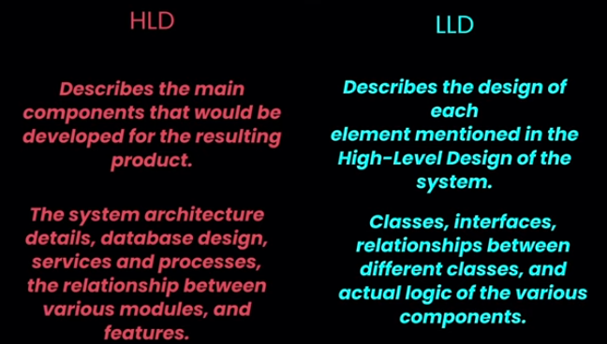

Slide 4
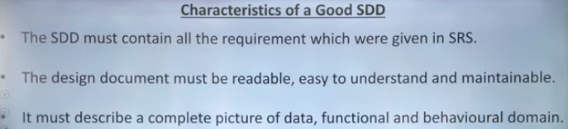

Slide 5
Translating the requirement model in to Design Model
Requirements model focuses on describing required data, function, and behaviour
Design Model :
Represents model of the software which provides detail about software architecture, data structures, interfaces, and components that are necessary to implement the system
Developed by Software engineers to conduct each of the design tasks.
Design allows you to model the system or product that is to be built.
Can be assessed for quality and improved before code is generated, tests are conducted, and end users become involved in large numbers.

Slide 6
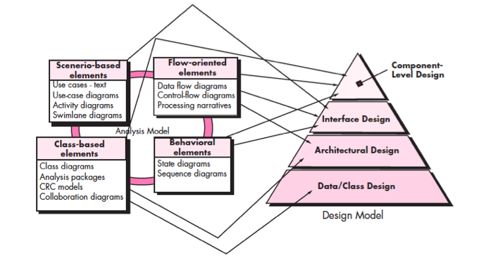
Translating the requirement model in to Design Model

Slide 7
Design Quality
Design Steps:
The architecture of the system or product must be represented.
The interfaces that connect the software to end users, to other systems and devices, and to its own constituent components are modelled.
The software components that are used to construct the system are designed.
Each of these views represents a different design action, but all must conform to a set of basic design concepts that guide software design work.
Outcome of Design Model
Architectural, interface, component level, and deployment representations
Design model is assessed by the software team to determine :
Whether it contains errors, inconsistencies, or omissions
Whether better alternatives exist
Whether the model can be implemented within the constraints, schedule, and cost that have been established.

Slide 8
Design
Software design is an iterative process through which requirements are translated into a “blueprint” for constructing the software.
Developers identify and prioritize the qualities of the system that they should optimize.
The design must implement all of the explicit requirements contained in the analysis model, and it must accommodate all of the implicit requirements desired by the customer.
Explicit Requirements: The Things You Wrote Down
Implicit Requirements: The Things Your Customers Will Expect
Latent Requirements: Things That Will Delight Your Customers
The design must be a readable, understandable guide for those who generate code and for those who test and subsequently support the software.
The design should provide a complete picture of the software, addressing the data, functional, and behavioral domains from an implementation perspective

Slide 9
Quality Guidelines
A design should exhibit an architecture that:
Is created using standard architectural patterns.
Is composed of components that exhibit good design characteristics.
Can be implemented in an evolutionary fashion
A design should be modular: logically partitioned into elements or subsystems
A design should contain distinct representations of data, architecture, interfaces, and components.
A design should lead to data structures that are appropriate for the classes to be implemented and are drawn from recognizable data patterns.

Slide 10
Quality Guidelines
5. A design should lead to components that exhibit independent functional characteristics.
6. A design should lead to interfaces that reduce the complexity of connections between components and with the external environment.
7. A design should be derived using a repeatable method that is driven by information obtained during software requirements analysis.
8. A design should be represented using a notation that effectively communicates its meaning.

Slide 11
Implementation
The implementation phase of software development is the process of converting a system specification into an executable system through the design of system.

Slide 12
Design Processes
The design process is a sequence of steps that enable the designer to describe all aspects of the software to be built.
The design process should not suffer from “tunnel vision.”- A good designer should consider alternative approaches.
The design should be traceable to the analysis model.- means for tracking how requirements have been satisfied by the design model.
The design should not reinvent the wheel. - Design time should be invested in representing truly new ideas and integrating those patterns that already exist.
The design should “minimize the intellectual distance” between the software and the problem as it exists in the real world. - structure of the software design should be replica of structure of the problem domain.

Slide 13
Design Processes
5. The design should exhibit uniformity and integration.
format should be defined for a design team before design work begins.
design is integrated if care is taken in defining interfaces between design components.
6. The design should be structured to accommodate change.
7. The design should be structured to degrade gently, even when aberrant data, events, or operating conditions are encountered.
Well designed software should never “bomb.”
It should be designed to accommodate unusual circumstances, and if it must terminate processing, do so in a graceful manner.

Slide 14
Design Processes
8. Design is not coding, coding is not design.
-the level of abstraction of the design model is higher than source code.
-only design decisions made at the coding level address the small implementation details.
9. The design should be assessed for quality as it is being created, not after the fact.
10. The design should be reviewed to minimize conceptual (semantic) errors.

Slide 15

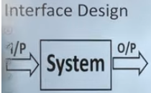
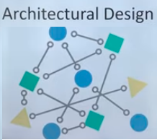
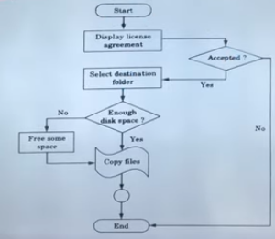
Design Activities
Software engineering design is a 3-step process:

Slide 16
Design Activities
1. Interface Design
Analogous to a set of detailed drawings.
Specifications of software
The interface design elements for software depict information flows into and out of the system and how it is communicated among the components defined as part of the architecture.
Important elements of interface design:
User Interface (UI)
External interface
Internal interface

Slide 17
Design Activities
2. Architectural Design
The architectural design for software is the equivalent to the floor plan(overview) of a house.
Architectural design elements give us an overall view of the software.
Architectural model is derived from three sources:
Information about the application domain for the software to be built
specific requirements
The availability of architectural Styles and patterns

Slide 18
Design Activities
3. Component Level/detailed Design
Analogous to a set of detail drawing and specifications of each room in a house.
The component-level design for software fully describes the internal detail of each software component.
Component-level design defines data structures for all local data objects and algorithmic detail.
Within the context of object-oriented software engineering, a component is represented in UML diagrammatic form.

Slide 19
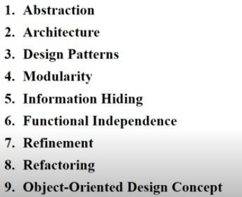
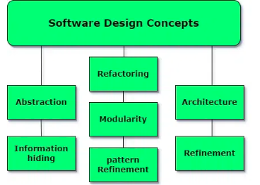
Software design concept

Slide 20

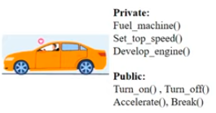
Design Concepts
Abstraction
Modular solution to any problem , many levels of abstraction can be posed.
At the highest level of abstraction, a solution is stated in broad terms using the language of the problem environment.
Lower levels of abstraction, a more procedural orientation is taken.
Each step in the software process is a refinement in the level of abstraction of the software solution.
A procedural abstraction is a named sequence of instructions that has a specific and limited function. (algorithm)

Slide 21

A data abstraction is a named collection of data that describes a data object

Slide 22
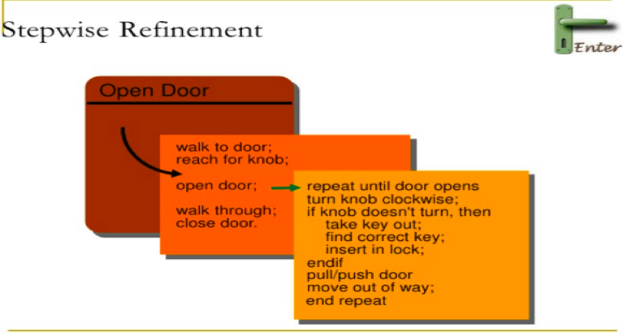
Design Concepts
2. Refinement
Refinement is process of elaboration
It’s a top-down design strategy
A program is developed by successively refining levels of procedural detail
Refinement causes the designer to elaborate on the original statement, providing more and more detail as each successive refinement (elaboration) occurs.
Abstraction and refinement are complementary concepts.

Slide 23
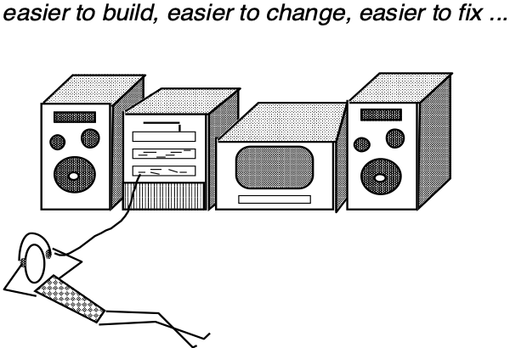
Design Concepts
3. Modularity
Software is divided into separately named and addressable components, often called modules, that are integrated to satisfy problem requirements.
Modularity is the single attribute of software that allows a program to be intellectually manageable.

Slide 24
Design Concepts
Modularity
"divide and conquer" an argument for modularity
it's easier to solve a complex problem when you break it into manageable pieces

Slide 25
Design Concepts
Modularity
Five criteria to define an effective modular system:
Modular decomposability – systematic mechanism for decomposing the problem into subproblems.
Modular composability – reusing existing system into new system yield modular solution and not reinvent wheel.
Modular understandability - understood as standalone unit , it will be easier to build and easier to change.
Modular continuity - small changes to the system requirements - changes to individual modules rather system – change induced side effects minimized.
Modular protection - irregular condition - error-induced side effects minimized.

Slide 26
Design Concepts
4. Software Architecture
Architecture- the overall structure of the software
Hierarchical structure of the software components (modules), the manner in which these components interact and the structure of data that are used by the components
Well designed architecture serves as framework for detailed design activities which can also help in reuse of design level concepts

Slide 27
Design Concepts
Software Architecture
Properties of architectural design:
Structural properties – defines the components of a system and their interaction with one another
Example: In a web application, structural properties might define how the front-end (user interface) components interact with the back-end (database and server logic).
Extra-functional properties– like performance, capacity, reliability, security, adaptability, and other system characteristics
Example: For a banking application, extra-functional properties might focus on ensuring high security, fast response times (performance), and the ability to handle a large number of transactions simultaneously (capacity).
Families of related systems- should draw upon repeatable patterns that are commonly encountered in the design of families of similar systems..
Example: When designing e-commerce platforms, architects might use a well-known pattern like the "Model-View-Controller" (MVC) to separate concerns and ensure a clear structure that can be easily adapted to different types of online stores.

Slide 28
Design Concepts
5. Patterns
A design pattern describes a design structure that solves a particular design problem within a specific context.
The intent of each design pattern is to provide a description that enables a designer to determine:
whether the pattern is applicable to the current work
whether the pattern can be reused
whether the pattern can serve as a guide for developing a similar, but functionally or structurally different pattern

Slide 29
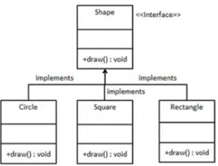
Example:

Slide 30
Design Concepts
6. Information Hiding
Hide the details of data structures and procedural processing behind a module interface.
Knowledge of the details need not be known by users
independent modules that communicate with one another only that information necessary to achieve software function
Information hiding provides the greatest benefits when modifications are required.
Because most data and procedural detail are hidden from other parts of the software errors less likely to propagate.

Slide 31
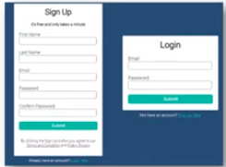
Example:

Slide 32
Design Concepts
7. Functional Independence:
Software should be designed such that each module addresses a specific subset of requirements and has a simple interface with other program structure.
Software with effective modularity, that is, independent modules, is easier to develop.
Independent modules
easier to maintain (and test)
effects caused by design or code modification limited
error propagation is reduced
reusable modules are possible.
functional independence is a key to good design, and design is the key to software quality.

Slide 33
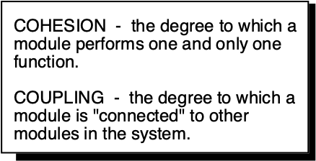
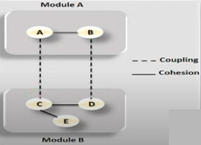
Design Concepts
Independence is assessed by qualitative criteria

Slide 34
Design Concepts
Cohesion:
A cohesive module performs a single task, requiring little interaction with other components in other parts of a program.
High degree of cohesion is advisable but it is also necessary and advisable for components to perform multiple functions.
Coupling:
Coupling is an indication of interconnection among modules in a software structure.
Coupling depends on the interface complexity between modules – entry point and type of data that passes through interface.
In software design, one should strive for the lowest possible coupling

Slide 35
Design Concepts
8. Refactoring:
Refactoring is the process of changing a software system in such a way that it does not alter the external behavior of the code [design] yet improves its internal structure.
When software is refactored:
the existing design is examined for redundancy
unused design elements
inefficient or unnecessary algorithms
poorly constructed or inappropriate data structures,
any other design failure that can be corrected to yield a better design.

Slide 36
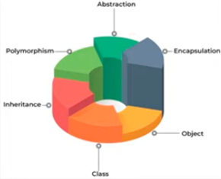
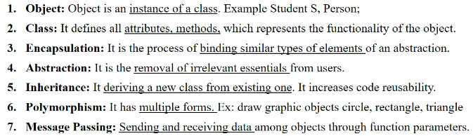
Object Oriented Design

Slide 38
Modularity and layered architecture
Modularity
It refers to dividing a program or system into separate parts that can be developed, tested, used, and understood independently.
Each module encompasses everything necessary to perform its specific function and typically has a clearly defined interface for interacting with other parts of the system.
Modularity allows developers to work on different parts of the system simultaneously, simplifies maintenance and upgrading of the product.
Example:
In an automobile manufacturing plant, the process is highly modular. Different parts of the car, such as the engine, transmission, chassis, and electronics, are designed and manufactured separately. Each module (e.g., the engine) can be developed, tested, and improved independently. Once all the modules are complete, they are assembled together to form the final product—a car.
This modular approach allows manufacturers to innovate and upgrade specific components without affecting the entire vehicle, making maintenance and upgrades more manageable.

Slide 39
Layered architecture
It is a way of organizing a system where components are separated into layers with clearly defined roles.
Each layer performs specific functions and provides services to the next level.
This architecture not only makes the system easier to understand and develop but also helps to isolate changes in one layer from affecting others.
Example: Restaurant Operations
In a restaurant, the operations can be viewed as layered architecture:
Presentation Layer (Waitstaff and Menu): The waitstaff interacts directly with customers, takes their orders, and serves food. The menu acts as the user interface where customers select what they want.
Business Logic Layer (Kitchen and Chef): The kitchen is where the business logic happens. The chef and kitchen staff prepare the food according to the orders taken by the waitstaff. This layer focuses on executing the core functions of the restaurant—preparing and cooking food.
Data Access Layer (Supply Chain and Inventory): The inventory system ensures that all ingredients are available when needed. The supply chain handles the procurement of these ingredients. This layer supports the business logic by providing the necessary resources.
These layers interact with each other to deliver a seamless dining experience. If there's a change in the menu (presentation layer), it may not necessarily affect the supply chain or inventory management directly

Slide 40
Design Model
Elements of Design Model
Data Design Elements:
Data Structures
Database architecture
Architectural Design Elements:
Equivalent to floor plan of a house
Sources for development of architectural design:
information about the application domain for the software to be built.
specific requirements model elements (data flow diagrams , collaboration etc.)
architectural styles and patterns

Slide 41
Design Model
Elements of Design Model
Interface Design Elements:
Equivalent to detailed drawings of a house
User Interface (UI)
External interface to other systems, devices, networks or other producers or consumers of information
Internal interfaces between various design components
Components- Level Design Elements:
Equivalent to a set of detailed drawings of a house
Relationship between the components
Deployment -Level Design Elements:
Indicate how software functionality and subsystems will be allocated within the software environment.

Slide 42
Pattern Based Software Design
•The best designers in any field have an uncanny ability to see patterns that characterize a problem and corresponding patterns that can be combined to create a solution.
•A description of a design pattern may also consider a set of design forces.
•Design forces describe non-functional requirements (e.g., ease of maintainability, portability) associated with the software for which the pattern is to be applied.
•The pattern characteristics (classes, responsibilities, and collaborations) indicate the attributes of the design that may be adjusted to enable the pattern to accommodate a variety of problems (problem solving).
•Throughout the design process, one should look for every opportunity to apply existing design patterns rather than creating new ones.

Slide 43
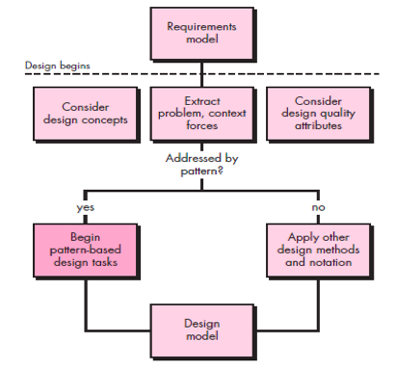
Pattern Based Software Design
1. Pattern-Based Design in Context
Use methods and modeling tools available for architectural, component level, and interface design.

Slide 44
Pattern Based Software Design
2. Thinking in Patterns
“new way of thinking” when one uses patterns as part of the design activity.
Good design begins by considering context—the big picture.
Approach that enables a designer to think in patterns:
Context of software build and requirements to be understood.
extract the patterns that are present at level of abstraction.
Begin design with “big picture” patterns that establish a context or skeleton for further design work.
“Work inward from the context” lower levels of abstraction that contribute to the design solution.
Repeat steps 1 to 4 until the complete design is fleshed out.
Refine the design by adapting each pattern to the specifics of the software

Slide 45
Design Model
3. Design Tasks
The following design tasks are applied when a pattern-based design philosophy is used:
Examine the requirements model and develop a problem hierarchy.
Determine if a reliable pattern language has been developed for the problem domain.
Beginning with a broad problem, determine whether one or more architectural patterns is available for it.
Using the collaborations provided for the architectural pattern , examine subsystem or component-level problems and search for appropriate patterns to address them.
Repeat steps until all broad problems have been addressed

Slide 46
Design Model
3. Design Tasks
The following design tasks are applied when a pattern-based design philosophy is used:
5. user interface design problems have been -search the many user interface design pattern repositories for appropriate patterns.
6. Compare various pattern against the existing ones for better designing.
7. Be certain to refine the design as it is derived from patterns using design quality criteria as a guide.

Slide 47
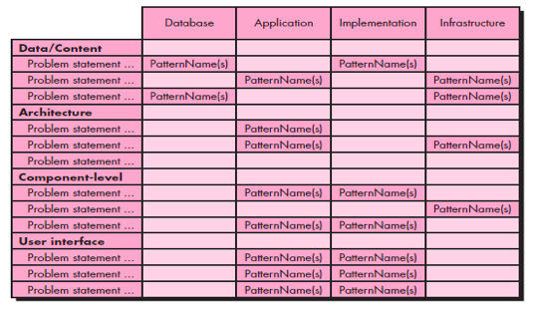
Design Model
4. Building a Pattern-Organizing Table
•As pattern based design proceeds organizing and categorizing problem may occur.
•Solution: A pattern-organizing table can be implemented as a spreadsheet model

Slide 48
Issued related to Architectural Patterns
Concurrency—applications must handle multiple tasks in a manner that simulates parallelism.
Example 1: Operating System Process Management pattern that provides built-in OS features that allow components to execute concurrently.
Example 2: Task Scheduler pattern invokes the next concurrent object
Distribution - The distribution problem addresses the manner in which systems or components within systems communicate with one another in a distributed environment.
Example 1: Broker pattern: broker acts as a middle man to constitute communication.

Slide 49
Issued related to Architectural Patterns
Persistence - Data persists if it survives past the execution of the process that created it.
Persistent data are stored in a database or file and modified later.
Example 1: Database management system pattern which stores and retrieves data.

